Slide 1
Week 13 progress report
Eunice Orenge
Laban Mwangi
Stephen Kinuthia
Victor Ngatia

Slide 2
01
Complete & test the buck converter.
Objectives
02
Receive and start tests using the new controller.

Slide 3
Complete and test the buck converter.
Upon completion of the board, we realised there were alot of short
circuits, so we decided to re-design the board and then redid the
whole etching.
We also managed to get terminal blocks and our board is almost
complete now.
01

Slide 4
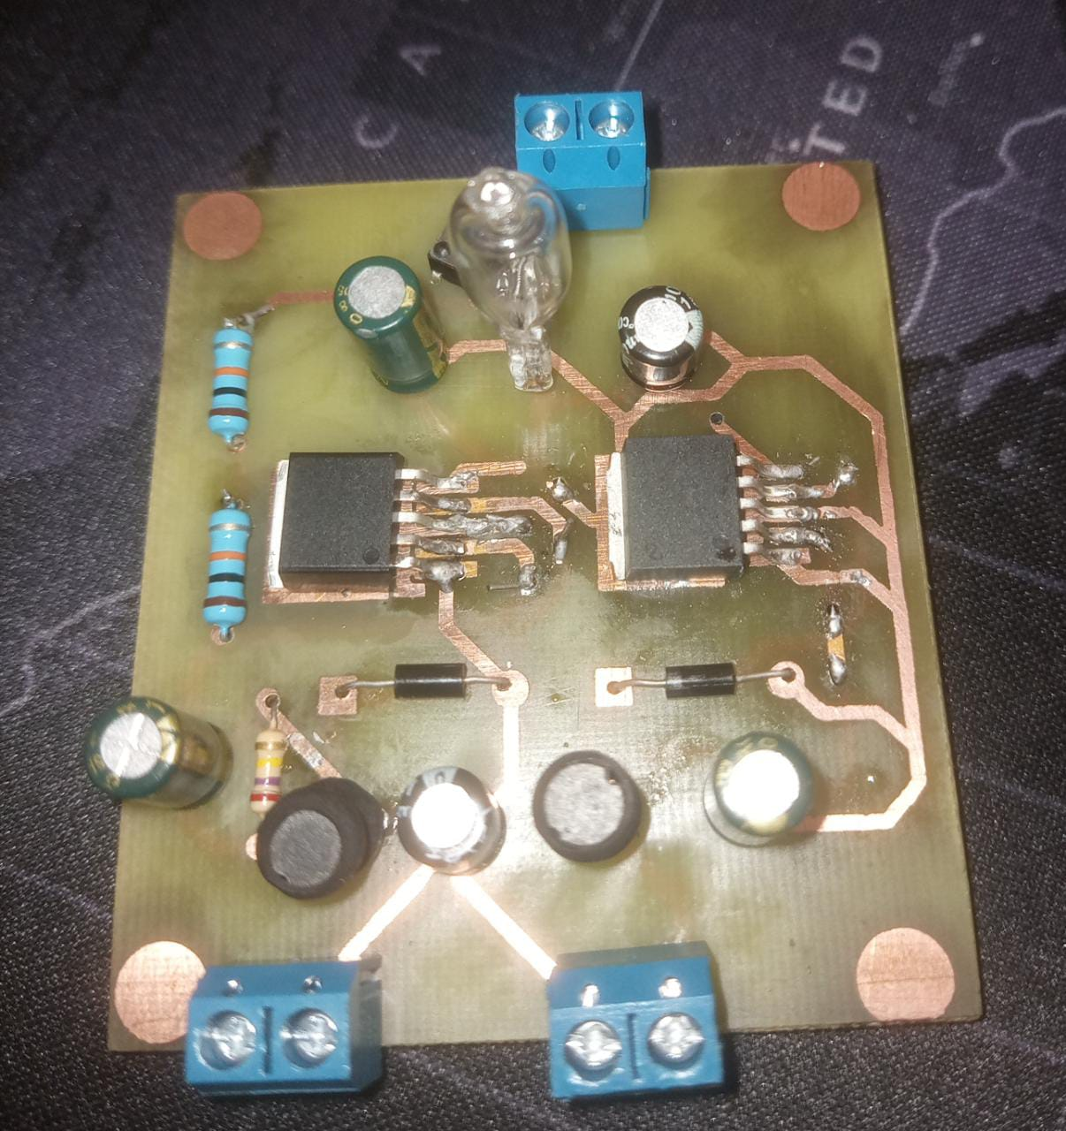
01
COMPLETE AND TEST BUCK CONVERTER

Slide 5
Receive and start tests using the new controller.
We still haven’t received the controller from the local
supplier. We therefore have not been able to start any
of the tests we had planned to do.
02

Slide 6
THE END ,
THANK YOU!

